Slide 1

Computer Architecture
Course Code: CSE360
Lecture 6
Input/Output

Slide 2
Input/Output Problems
Wide variety of peripherals
  Delivering different amounts of data
  At different speeds
  In different formats
All slower than CPU and RAM
Need I/O modules

Slide 3
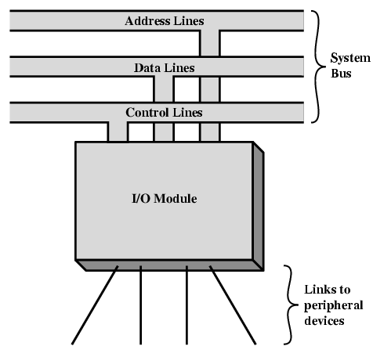
Generic Model of I/O Module
Each module interfaces to the system buses and controls, and one or more peripheral devices
The I/O module contains logic for performing a communication function between the peripheral and the bus.

Slide 4
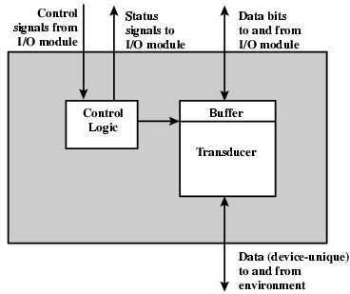
External Device Block Diagram
Interface to the I/O module in the form of control, data, and status signals.
Control signals determine function that device will perform, such as send data to I/O module (INPUT or READ), accept data from I/O module (OUTPUT or WRITE), report status, or perform control function (e.g. position a disk head)
Data are in the form a set of bits to be sent to or received from I/O module
Status signals indicate (READY/NOT-READY) during data transfer
Control logic controls external device’s operation in response to direction from I/O module
The transducer converts data from electrical to other forms of energy during output and from other forms to electrical during input
A buffer is associated with transducer to temporarily hold data being transferred between I/O module and external environments (a buffer size of 8 to 16 bits is common)

Slide 5
I/O Steps
The control of the transfer of data from an external device to the processor involves following steps:
CPU interrogates I/O module to check the status of the attached external device
I/O module returns the device status
If the device is ready, CPU requests data transfer
I/O module gets data (e.g. 8 or 16 bits) from external device
I/O module transfers data to CPU

Slide 6
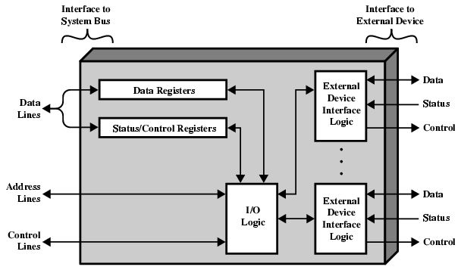
I/O Module Diagram

Slide 7
I/O Module Structure
Data transferred to and from the module are buffered in one or more data registers
There may also one or more status registers that provide current status information
A status register may also function as control register, to accept detailed control information from the processor
The logic within the module interacts with the processor via a set of control lines.
The processor uses control lines to issue commands to the I/O module
Some of the control lines may be used by the I/O module
The module must also be able to recognize and generate addresses associated with the devices it controls
Each I/O module has a unique address or, if it controls more than one external device, a unique set of addresses
Finally, the I/O module contains logic specific to the interface with each external device that it controls

Slide 8
Input Output Techniques
Programmed I/O
  Data are exchanged between processor and I/O module
  The processor executes a program that gives direct control of I/O operation, including sensing device status, sending a read or write command, and transferring data
  When processor issues a command to I/O module, it must wait until I/O operation is complete
  If the processor is faster than I/O module, this is wasteful of processor time.
Interrupt driven I/O
  The processor issues an I/O command, continues to execute other instructions, and is interrupted by the I/O module when the later has completed its work
  → With both programmed and interrupt I/O, the processor is responsible for extracting data from main memory for output and storing data in main memory for input
Direct Memory Access (DMA)
  The I/O module and main memory exchange data directly without processor involvement.

Slide 9
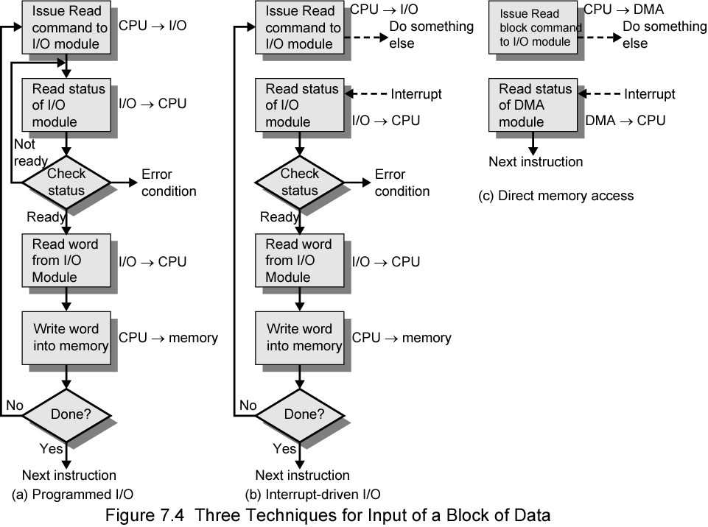
Three Techniques for
Input of a Block of Data

Slide 10
Programmed I/O
CPU has direct control over I/O
  Sensing status
  Read/write commands
  Transferring data
CPU waits for I/O module to complete operation
Wastes CPU time

Slide 11
Programmed I/O - detail
CPU requests I/O operation
I/O module performs operation
I/O module sets status bits
CPU checks status bits periodically
I/O module does not inform CPU directly
I/O module does not interrupt CPU
CPU may wait or come back later

Slide 12
I/O Mapping
Memory mapped I/O
  Single address space for memory locations and I/O devices
  The processor treats the status and data registers of I/O modules as memory locations and uses same machine instructions to access both memory and I/O devices
  Devices and memory share an address space (e.g. with 10 address lines, a combined total of 1024 memory locations and I/O address can be supported, in any combination)
  No special commands for I/O
Isolated I/O
  The bus may be equipped with memory read and write plus input and output command
  Now the command line specifies whether the address refers to a memory location or an I/O device
  Separate full range of address spaces for both (e.g. with 10 address lines, the system may support both 1024 memory locations and 1024 I/O addresses
  Special commands for I/O
  The address space for I/O is isolated from that of memory

Slide 13
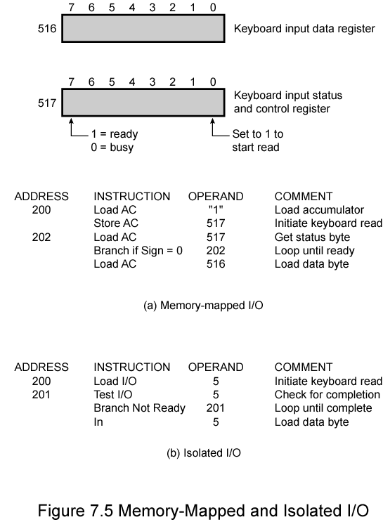
Memory Mapped and Isolated I/O
Keyboard input appears to a programmer
Assume a 10 bit address, with a 512-bit memory (locations 0-511) and up to I/O addresses (locations 512-1023).
Two addresses are dedicated to keyboard input from a particular terminal
Address 516 refers to data register and address 517 refers to status register
The program will read 1 byte of data from keyboard into an accumulator register in the processor. The processor loops until the data byte is available.
With isolated I/O, the ports are accessible only by special I/O commands, which activate the I/O command lines on the bus.

Slide 14
I/O Mapping (Advantages and Disadvantages)
Memory mapped I/O
    The advantage is that a large selection of memory access commands available, allowing more efficient programming
    A disadvantage is that valuable memory address is used up
Isolated I/O
  If isolated I/O is used, there are only a few I/O instructions; which is treated as major advantage
  Limited set of special commands for I/O; which is the limitation

Slide 15
Interrupt Driven I/O
Overcomes CPU waiting
No repeated CPU checking of device
I/O module interrupts when ready

Slide 16
Interrupt Driven I/O
Basic Operation
CPU issues read command
I/O module gets data from peripheral whilst CPU does other work
I/O module interrupts CPU
CPU requests data
I/O module transfers data

Slide 17
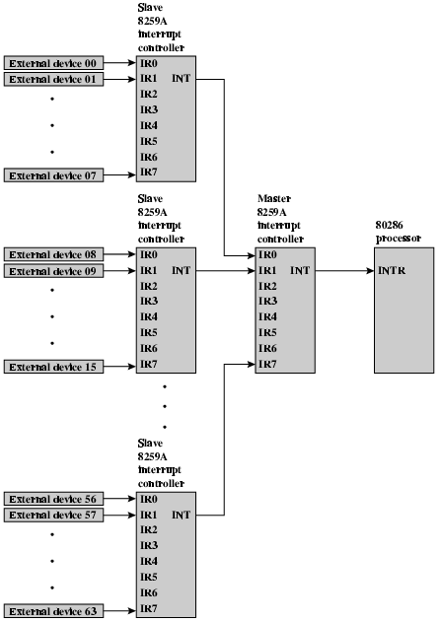
82C59A Interrupt
Controller

Slide 18
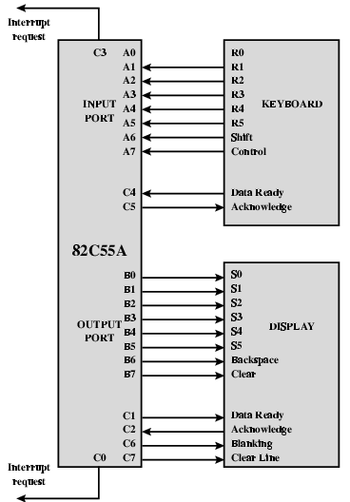
Keyboard/Display Interfaces to 82C55A

Slide 19
Direct Memory Access
Interrupt driven and programmed I/O require active CPU intervention to transfer data between memory and an I/O module
  The I/O transfer rate is limited by the speed
  CPU is tied up in managing an I/O transfer; a number of instructions must be executed for each I/O transfer
Using simple programmed I/O, the processor is dedicated to the task of I/O and can move data at high rate at the cost of doing nothing else
Interrupt I/O frees up the processor to some extent at the expense of the I/O transfer rate.
Nevertheless, both methods have an averse impact on both processor activity and I/O transfer rate
DMA is the answer

Slide 20
DMA Function
DMA involves an additional Module (hardware) on bus
DMA controller takes over control of the system bus from processor
It needs to do this to transfer data to and from memory over the system bus
The DMA module use the bus only when processor does not need it, or it must force the processor to suspend operation temporarily
The later technique is referred to as cycle stealing, because DMA module steals a bus cycle

Slide 21
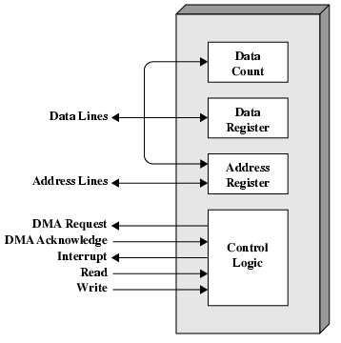
Typical DMA Module Diagram

Slide 22
DMA Operation
CPU tells DMA controller:-
  Read/Write
  Device address
  Starting address of memory block for data and stored by the DMA module in its address register
  Number of words to be transferred via the data lines and stored in data count register
CPU carries on with other work
DMA controller deals with data transfer directly to or from memory without going through processor
DMA controller sends interrupt when finished
The processor is involved only at the beginning and end of data transfer

Slide 23
DMA Transfer
Cycle Stealing
DMA controller takes over bus for a cycle
Transfer of one word of data and returns control to the processor
This is not an interrupt; rather the processor pauses for one bus cycle
  CPU does not save a context and do something else
CPU suspended just before it accesses bus
  i.e. before an operand or data fetch or a data write
The processor execute more slowly
Nevertheless, for a multiple-word I/O transfer, DMA is far more efficient than interrupt driven or programmed I/O

Slide 24
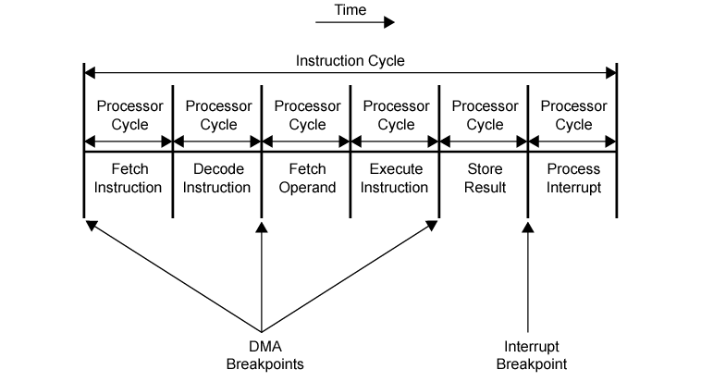
DMA and Interrupt Breakpoints During an Instruction Cycle

Slide 25
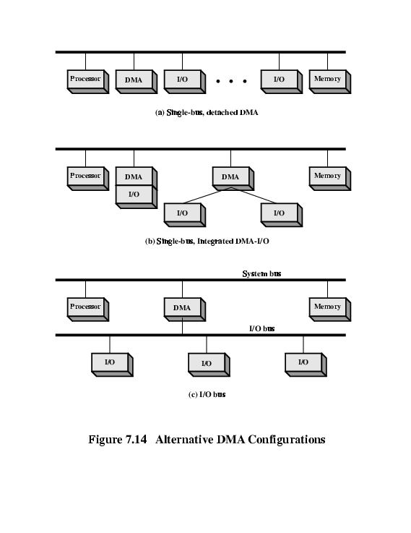
DMA Configurations (1)
Single Bus, Detached DMA controller
All modules share the system bus
Each transfer uses bus twice
  I/O to DMA then DMA to memory
CPU is suspended twice

Slide 26
DMA Configurations (2)
Single Bus, Integrated DMA controller
Controller may support >1 device
Each transfer uses bus once
  DMA to memory
CPU is suspended once

Slide 27
DMA Configurations (3)
Separate I/O Bus
Bus supports all DMA enabled devices
Each transfer uses bus once
  DMA to memory
CPU is suspended once

Slide 28
Intel 8237A DMA Controller
Interfaces to 80x86 family and DRAM
When DMA module needs buses it sends HOLD signal to processor
CPU responds HLDA (hold acknowledge)
  DMA module can use buses
E.g. transfer data from memory to disk
  The peripheral device (such as disk controller) requests service of DMA by pulling DREQ (DMA request) high
  DMA puts high on HRQ (hold request), signaling the CPU through its HOLD pins that it needs to use bus
  CPU finishes present bus cycle (not necessarily present instruction) and respond to DMA request by putting high on HDLA (hold acknowledge), thus telling the DMA that it can go ahead and HOLD remains active as long as DMA is performing task
  DMA activates DACK (DMA acknowledge), telling device to start transfer
  DMA starts transfer from memory to peripheral by putting address of first byte on address bus and activating MEMR; it then activates IOW to write to peripheral. DMA decrements counter and increments address pointer. Repeat until count reaches zero
  DMA deactivates HRQ, giving bus back to CPU

Slide 29
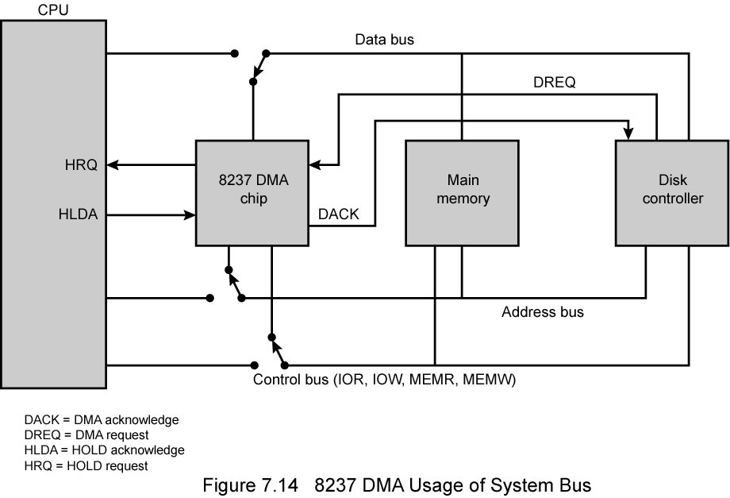
8237 DMA Usage of Systems Bus

Slide 30
I/O Channels
I/O devices getting more sophisticated
e.g. 3D graphics cards
CPU instructs I/O controller to do transfer
I/O controller does entire transfer
Improves speed
  Takes load off CPU
  Dedicated processor is faster

Slide 31
The Evolution of the I/O function
The CPU directly controls a peripheral device.
A controller or I/O module is added. The CPU uses programmed I/O without interrupts
The same configurations as in step 2 is used, but now interrupts are employed. The CPU need not spend time waiting for an I/O operation to be preformed, increasing efficiency
The I/O module is given direct access to memory via DMA. It can transfer data to or from memory without involving CPU
The I/O module (often referred to as I/O channel) is enhanced to become a processor, with a specialized instruction set for I/O. The CPU directs I/O processor to execute I/O program in memory. The I/O processor fetches and executes these instructions without CPU intervention
The I/O module has a local memory of its own. With this architecture, a large set of I/O devices can be controlled with minimal CPU involvement

Slide 32
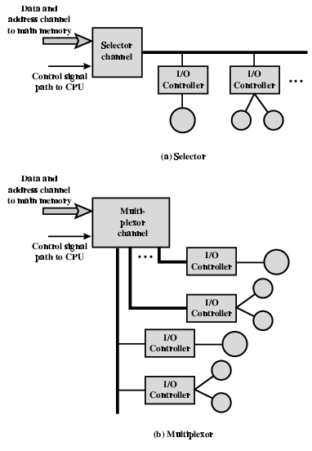
I/O Channel Architecture
Two types of I/O channels are common.
A selector channel controls multiple high-speed devices and at any one time, is dedicated to the transfer of data with one of those devices
Thus, the I/O channel selects one device and effects the data transfer
Each device or a small set of devices, is handled by a controller or I/O module
Thus I/O channel serves in controlling these I/O controllers
A multiplexor channel can handle I/O with multiple devices at the same time.
For low-speed device, a byte multiplexer accepts or transmits characters as fast as possible to multiple devices
For high speed devices, a block multiplexer interleaves blocks of data from several devices

